Slide 1
Convolution Neural Network

Slide 2
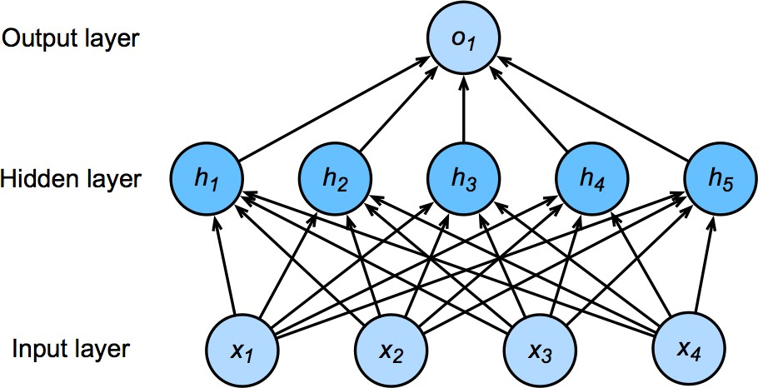
Flashback - Network with one hidden layer
64 x 64 x 3
1000 x 1000 x 3
If hidden layers has 1000 neurons. Parameters to estimate – 1000 *1000*3*1000=3 Billion
h = σ (Wx + b)

Slide 3
Solution - Convolutional Neural Network
Images exhibit rich structure that can be exploited by humans and machine learning models alike.
Convolutional neural networks (CNNs) are one creative way that machine learning has embraced for exploiting some of the known structure in natural images.

Slide 4
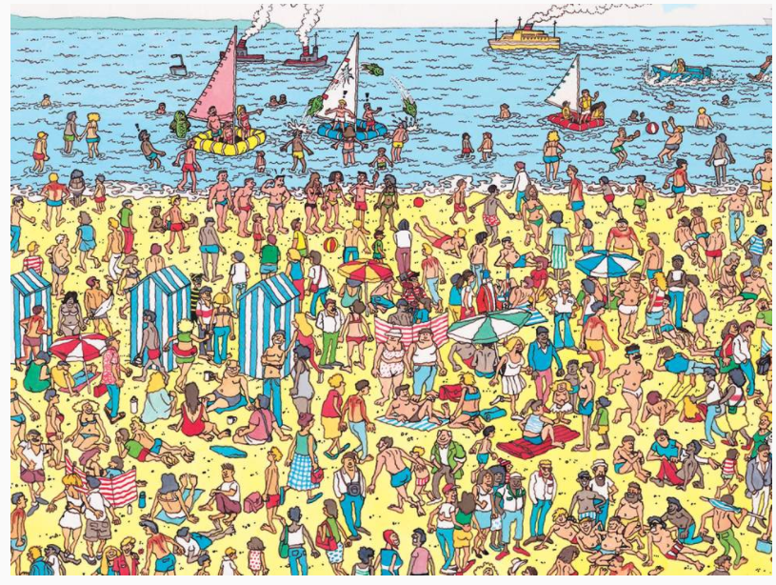
Two Principles
Translation Invariance
In the earliest layers, our network should respond
similarly to the same patch, regardless of where it
appears in the image.
Locality
The earliest layers of the network should focus on local regions, without regard for the contents of the image in distant regions. This is the locality principle.
Eventually, these local representations can be aggregated to make predictions at the whole image level

Slide 5
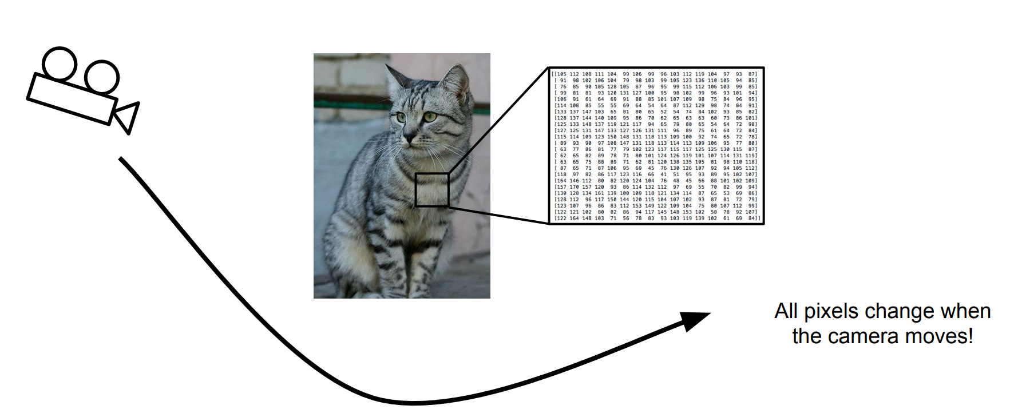
Translational Invariance - importance
Source: http://cs231n.stanford.edu/slides/2018/cs231n_2018_lecture02.pdf

Slide 6
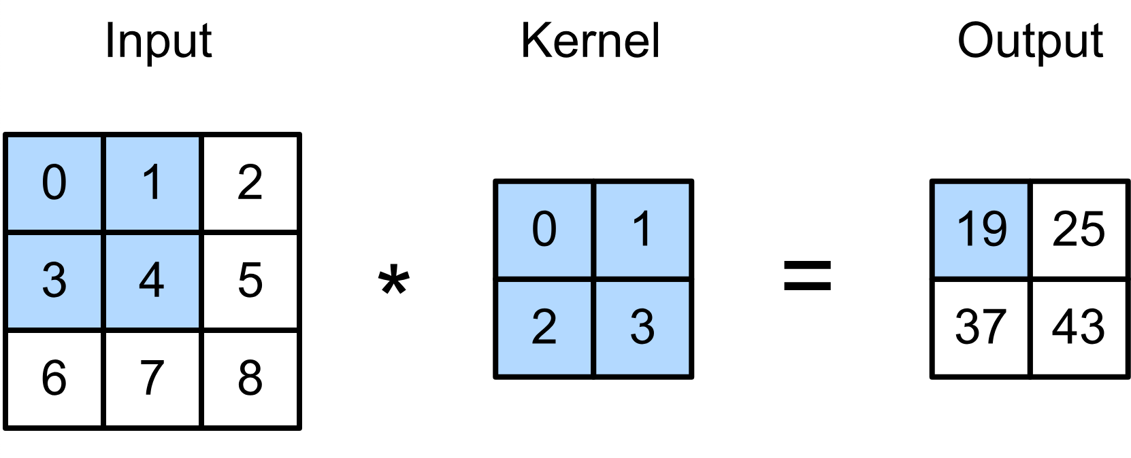
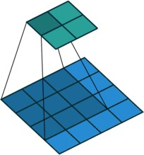
2-D Cross Correlation
0 × 0 + 1 × 1 + 3 × 2 + 4 × 3 = 19,
1 × 0 + 2 × 1 + 4 × 2 + 5 × 3 = 25,
3 × 0 + 4 × 1 + 6 × 2 + 7 × 3 = 37,
4 × 0 + 5 × 1 + 7 × 2 + 8 × 3 = 43.
(vdumoulin@ Github)
Slide credit: Alex Smola and Mu Li (Berkley)

Slide 7
2-D Cross Correlation
0 × 0 + 1 × 1 + 3 × 2 + 4 × 3 = 19,
1 × 0 + 2 × 1 + 4 × 2 + 5 × 3 = 25,
3 × 0 + 4 × 1 + 6 × 2 + 7 × 3 = 37,
4 × 0 + 5 × 1 + 7 × 2 + 8 × 3 = 43.
(vdumoulin@ Github)
Slide credit: Alex Smola and Mu Li (Berkley)

Slide 8
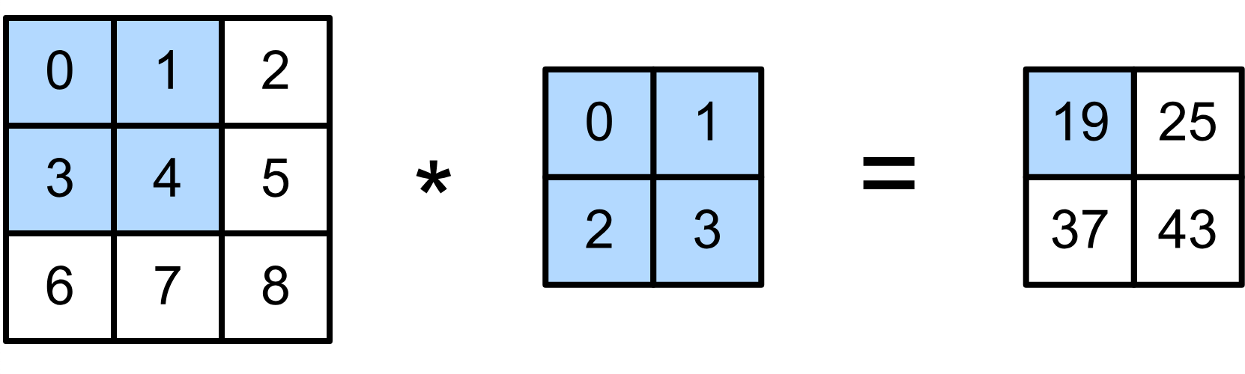
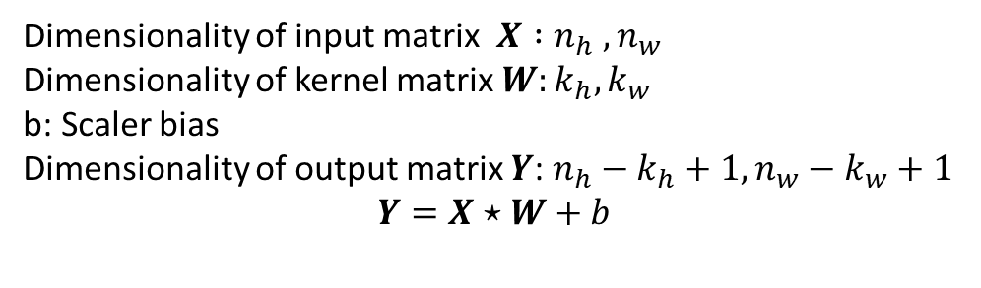
2-D Convolution Layer
Dimensionality of input matrix $X :n_{h} , n_{w}$
Dimensionality of kernel matrix $W:k_{h}, k_{w}$
b: Scaler bias
Dimensionality of output matrix $Y$: $n_{h}−k_{h}+1, n_{w}−k_{w}+1$
$$Y=X⋆W+b$$

Slide 9
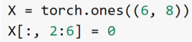
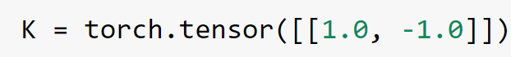
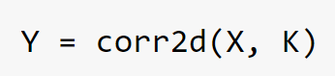
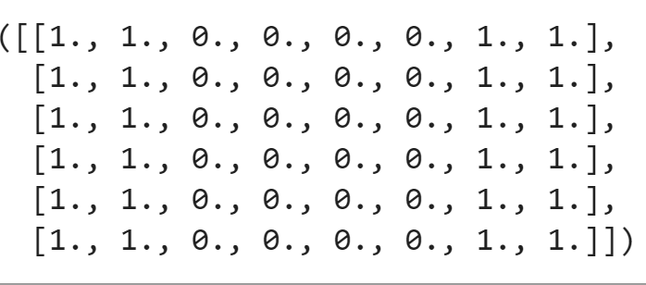
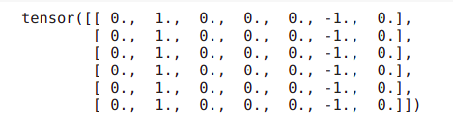
Edge Detection

Slide 10
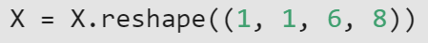
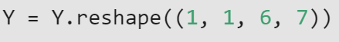
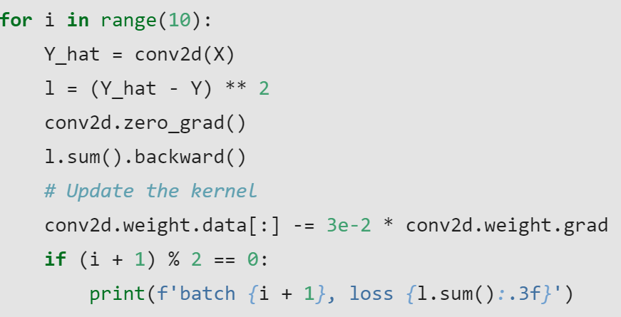
Learning a Kernel
Input channels, output channels, kernel size
(Batch_size, number of channels, height, width)

Slide 11
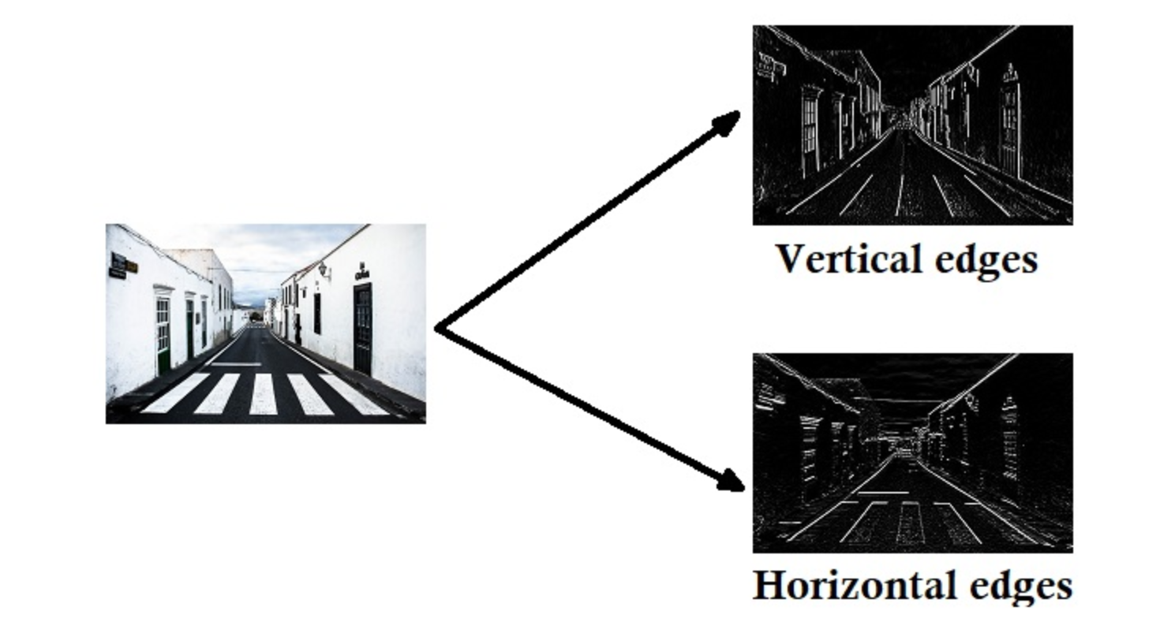
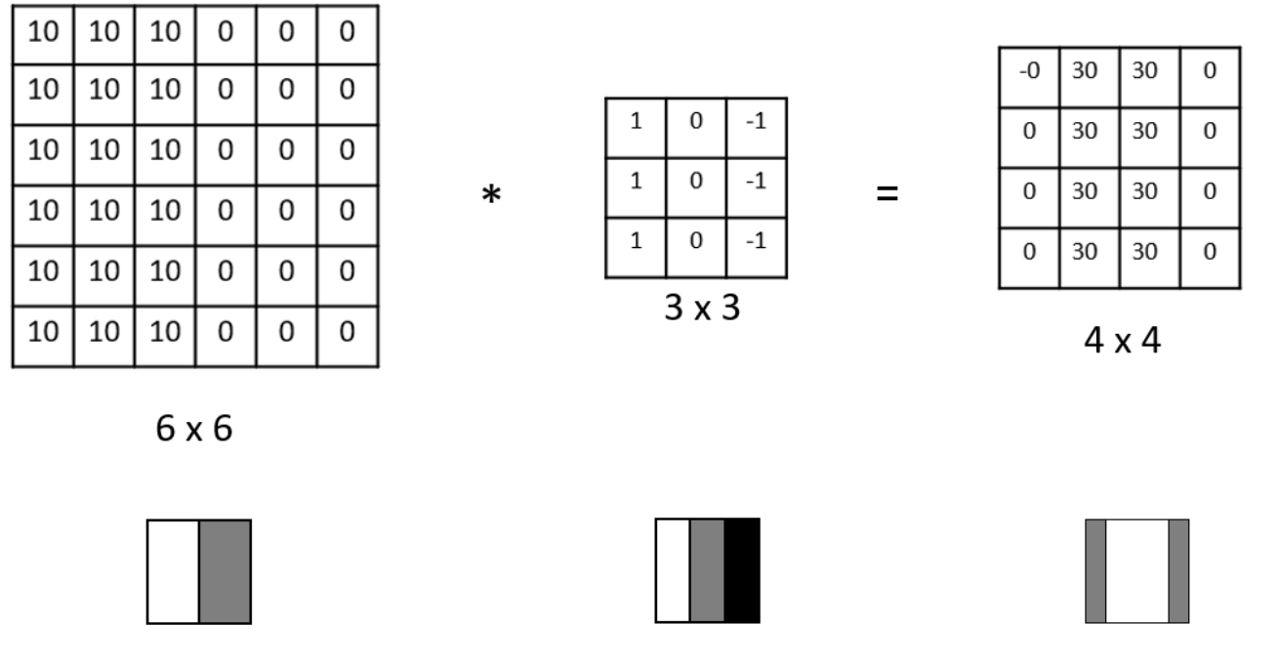
More Edge Detection examples
Vertical edge detection
Source Figures : http://datahacker.rs/edge-detection/

Slide 12
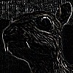
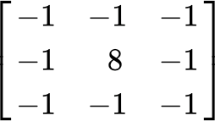


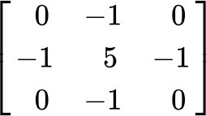
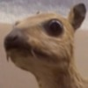
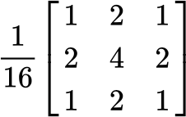
Examples
Edge Detection
Sharpen
(wikipedia)
Gaussian Blur
Slide credit: Alex Smola and Mu Li (Berkley)

Slide 13
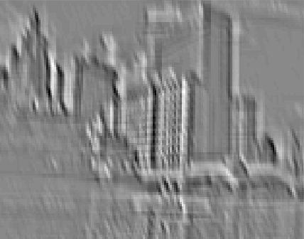
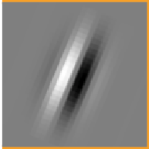
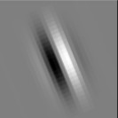
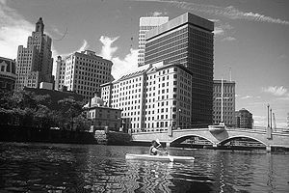
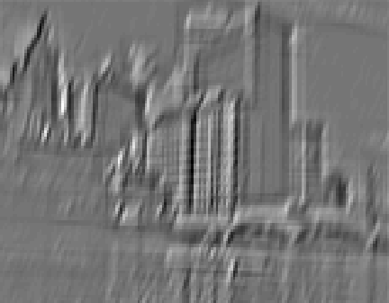
Examples
(Rob Fergus)
Slide credit: Alex Smola and Mu Li (Berkley)

Slide 14
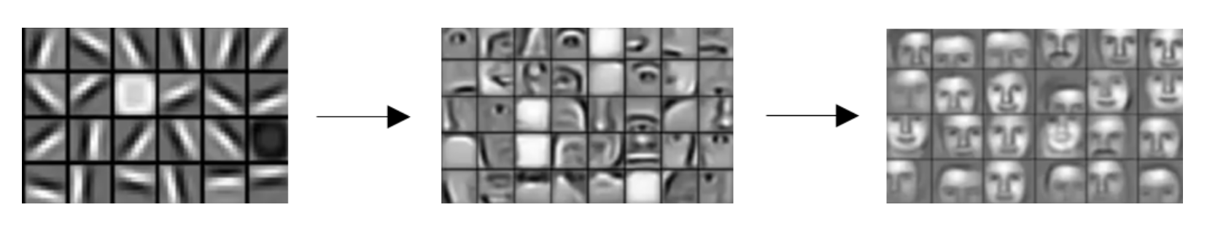
Examples
Source Figures : http://datahacker.rs/edge-detection/

Slide 15
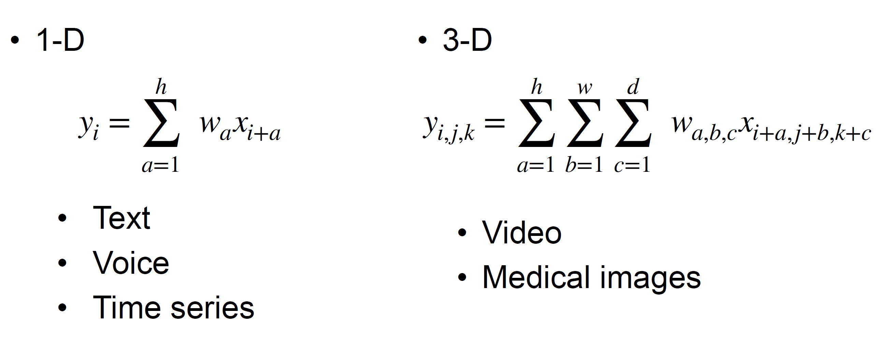
1-D and 3-D Cross Correlations

Slide 16
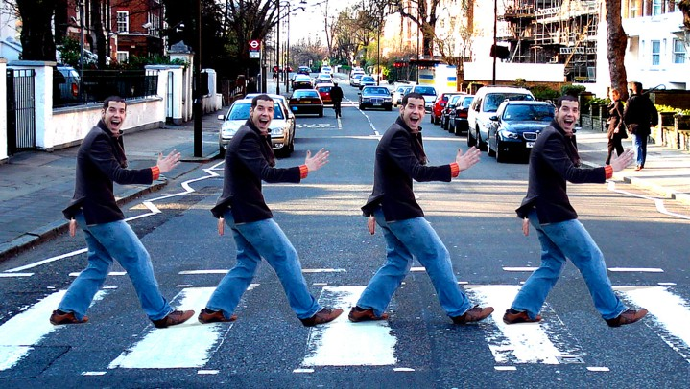
Padding and Stride
Slide credit: Alex Smola and Mu Li (Berkley)
courses.d2l.ai/berkeley-stat-157

Slide 17
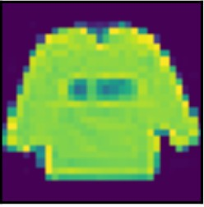

Padding
Given a 32 x 32 input image
Apply convolutional layer with 5 x 5 kernel
28 x 28 output with 1 layer
4 x 4 output with 7 layers
Shape decreases faster with larger kernels
Shape reduces from
n_{h} × n_{w} to
(n_{h} − k_{h} + 1) × (n_{w} − k_{w} + 1)
Slide credit: Alex Smola and Mu Li (Berkley)

Slide 18
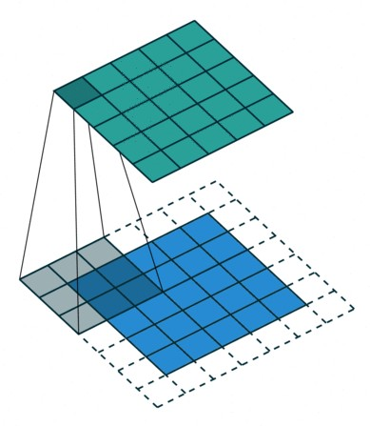
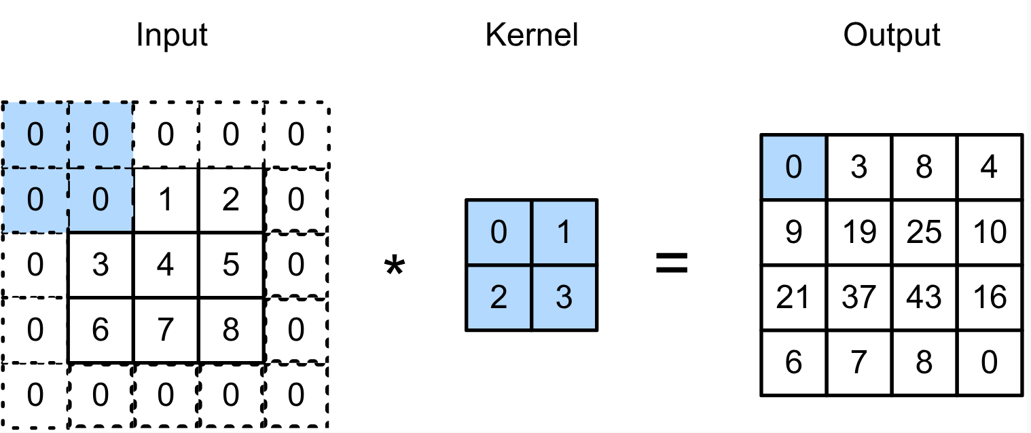
Padding
Padding adds rows/columns around input
0 × 0 + 0 × 1 + 0 × 2 + 0 × 3 = 0
Slide credit: Alex Smola and Mu Li (Berkley)

Slide 19
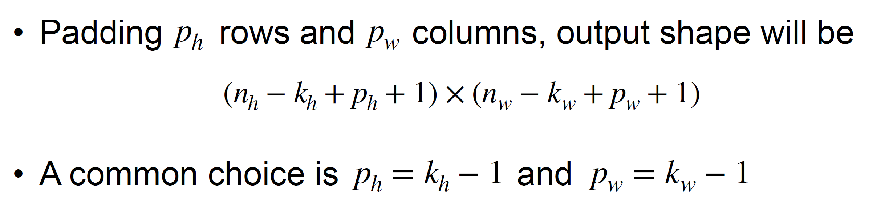
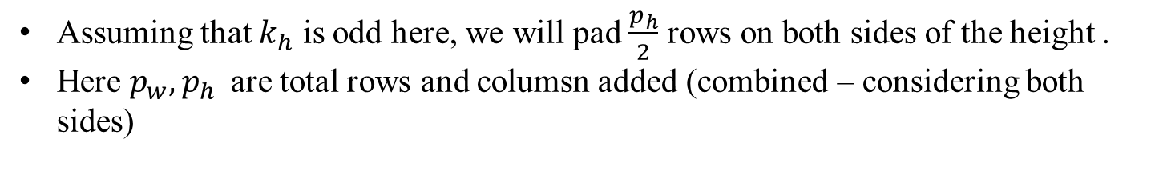
Padding
Assuming that $k_{h}$ is odd here, we will pad $\frac{p_{h}}{2}$ rows on both sides of the height .
Here ${p_{w}, p}_{h }$ are total rows and columsn added (combined – considering both sides)
If size of output is same as input – “same” Convolution
If size of output is smaller than output – “valid” Convolution

Slide 20
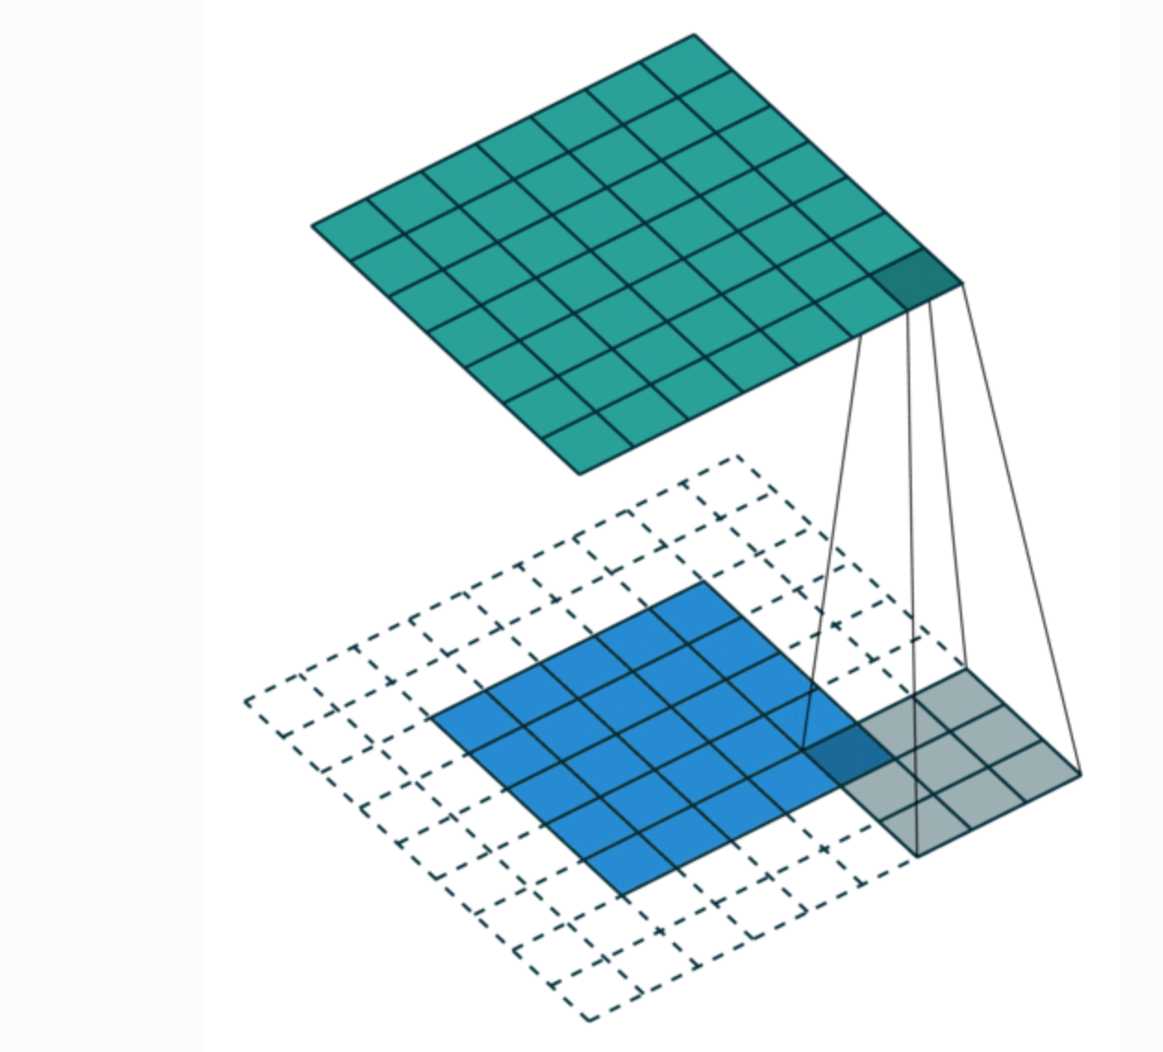
Full Padding
In this setting every possible partial or complete superimposition of the kernel on the input feature map is taken into account.
Size of output will be greater than input.
Rarely used in practice.

Slide 21

Stride
Padding reduces shape linearly with #layers
Given a 224 x 224 input with a 5 x 5 kernel, needs 44 layers to reduce the shape to 4 x 4
Requires a large amount of computation
Slide credit: Alex Smola and Mu Li (Berkley)

Slide 22
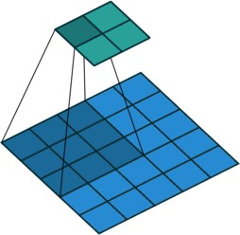
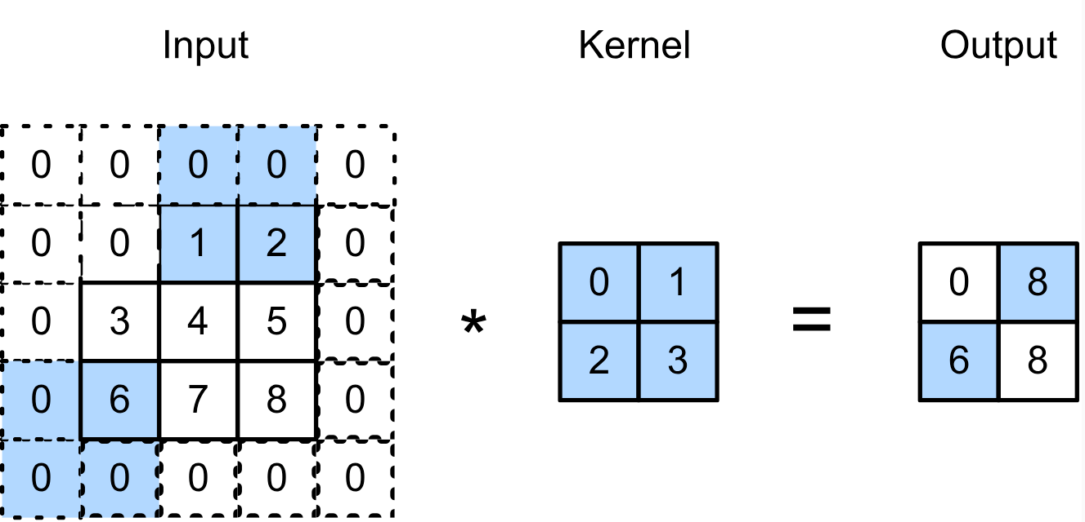
Stride
Stride is the #rows/#columns per slide
Strides of 3 and 2 for height and width
0 × 0 + 0 × 1 + 1 × 2 + 2 × 3 = 8
0 × 0 + 6 × 1 + 0 × 2 + 0 × 3 = 6
Slide credit: Alex Smola and Mu Li (Berkley)

Slide 23
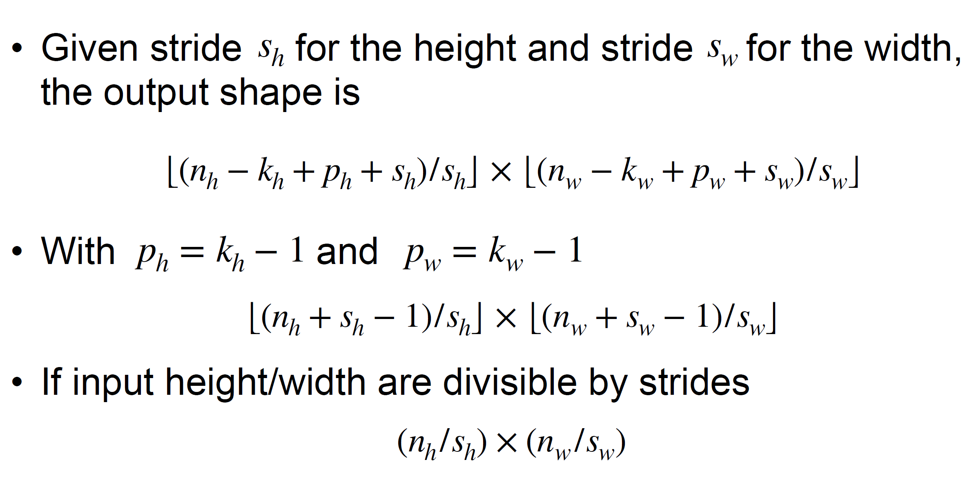
Stride
Slide credit: Alex Smola and Mu Li (Berkley)

Slide 24


Padding Code PyTorch
Here $k_{h}=k_{w}=3, p_{h}=p_{w}=2$
Note that here 1 row and column is padded on either side, so a total of 2
Here $k_{h}=5, k_{w}=3, p_{h}=4, p_{w}=2$

